Slide 1
Unit-1 Concept and Aims of Teaching of Mathematics
Topic-: The Nature of Mathematical Propositions, Use of Quantifiers and Venn Diagrams
By- Dr. Meena Sharma

Slide 2
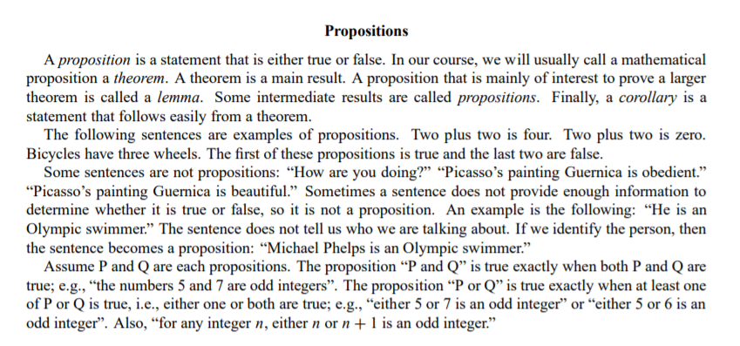
Propositions
Details

Slide 10
IMPORTANCE OF VENN DIAGRAMS

Slide 11
Fight COVID-19
Stay Home
Stay Healthy
Wash Hands
Use “Aarogya Setu” App
Maintain Social Distancing
Thank You

